Slide 1
IRIS & DSpace-CRIS an update
euroCRIS
May 12, 2015
Susanna Mornati, Andrea Bollini

Slide 2
Talking about
Cineca activities in Italy
DSpace-CRIS in a nutshell
The 4.3.0 release
Next major goals

Slide 3
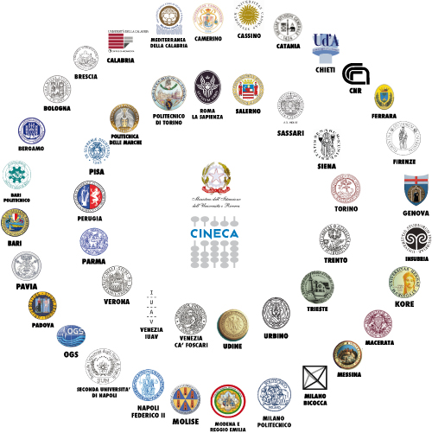
CINECA
Interuniversity Consortium
Not for Profit
Founded in 1969
Headquarter in Bologna
75 Members
70 Universities
4 Research Institutes
Ministry of Education
Employees: > 900
Offices: Bologna, Milan & Rome
Turnover: >100M

Slide 4
International Activities in HE
Institutional
Technological
EUNIS
Board Member | Interoperability TF | Business Intelligence TF | BencHEIT TF
CHEITA
Leading Member | Benchmarking IT Group | Research Group
euroCRIS
Board Member | DRIS/Best Practice TG | Architecture TG | CERIF TG
Groningen Declaration
Founder Member
DSpace
Steering Committee | 2 Committers | Registered Service Provider | DSpace-CRIS
EAIE
Student Mobility Standard: RS3G
OpenAIRE
National Open Access Desk
Pentaho
Member of the Advisory Board

Slide 5

> 50,000 Researchers
> 1.5 Million Research Publications
83 CRIS
45 Universities (U-GOV RI)
10 Universities (SURplus)
10 New Installations (IRIS)
18 Universities Abroad
(IRIS & DSpace-CRIS)

Slide 6
Fondazione Bruno Kessler | FBK | U | consegnata | giugno
Basilicata | UNIBAS | U | consegnata | marzo
Venezia IUAV | IUAV | U | consegnata | giugno
Roma LUISS | LUISS | U | consegnata | marzo
Milano Politecnico | POLIMI | U | consegnata | giugno
Torino Politecnico | POLITO | U | consegnata
Camerino | UNICAM | U | consegnata | giugno
Pisa Normale | SNS | U | consegnata | febbraio
Chieti | UNICH | U | consegnata | marzo
Como eCampus | UNIECAMPUS | U | consegnata | aprile
Pisa Sant'Anna | SSSUP | U | consegnata | 2014
Bari | UNIBA | NUOVA | in coda
Bologna | UNIBO | U | consegnata | luglio
Milano Bocconi | UNIBOCCONI | U | consegnata | giugno
Brescia | UNIBS | U | consegnata | gennaio
Cagliari | UNICA | NUOVA | in coda
Cassino | UNICAS | U | consegnata | giugno
Ferrara | UNIFE | U | consegnata | aprile
Foggia | UNIFG | U | consegnata | gennaio
Macerata | UNIMC | U | consegnata | marzo
Marche Politecnico | UNIVPM | U | consegnata | aprile
Firenze | UNIFI | U | consegnata | aprile
Genova | UNIGE | U | consegnata | aprile
Enna | UNIKORE | U | consegnata | marzo
Napoli Federico II | UNINA | U | consegnata
Lecce | UNILE | U | in coda
Messina | UNIME | U | consegnata | aprile
Modena Reggio | UNIMORE | U | consegnata | 2014
Insubria | UNINSUBRIA | U | consegnata | febbraio
Napoli l'Orientale | UNIOR | U | consegnata | maggio
Napoli Parthenope | UNIPARTHENOPE | NUOVA | consegnata | 2014
Padova | UNIPD | U | consegnata | giugno
Perugia | UNIPG | U | consegnata | marzo
Pisa Statale | UNIPI | U | consegnata | aprile
Piemonte Orientale | UNIPMN | U | consegnata | giugno
Parma | UNIPR | U | consegnata | 2014
Pavia | UNIPV | U | consegnata | aprile
Roma Sapienza | UNIROMA1 | U | consegnata | maggio
Salerno | UNISA | U | consegnata | marzo
Siena | UNISI | U | consegnata | gennaio
Sassari | UNISS | NUOVA | consegnata | maggio
Teramo | UNITE | U | consegnata | maggio
Trento | UNITN | U | consegnata | aprile
Torino Statale | UNITO | U | consegnata | maggio
Trieste | UNITS | U | consegnata | 2014
Cosenza | UNICAL | NUOVA | consegnata | giugno
Udine | UNIUD | U | consegnata | marzo
Urbino | UNIURB | U | consegnata | maggio
Venezia Ca' Foscari | UNIVE | U | consegnata | maggio
Verona | UNIVR | U | consegnata | maggio
Milano Statale | UNIMI | S+ | consegnata | 2014
Milano Bicocca | UNIMIB | S+ | consegnata | 2014
Roma Tor Vergata | UNIROMA2 | S+ | consegnata | aprile
Libera Univ. Lingue Com. | IULM | S+ | in corso | giugno
Palermo | UNIPA | S+ | consegnata | gennaio
Ente Ricerca Agricoltura | CRA | S+ | in coda
Fondazione E. Mach | FMACH | S+ | consegnata | maggio
Milano Cattolica | UNICAT | S+ | in coda | settembre
Bergamo | UNIBG | S+ | consegnata | maggio
MUSE | MUSE | S+ | in corso | maggio
L'Aquila |  | NUOVA |  | settembre
Roma 3 |  | NUOVA |  | settembre
Molise |  | NUOVA |  | settembre
Hunimed - Humanitas |  | NUOVA |  | settembre
INRIM |  | NUOVA |  | settembre
IRIS in Italy
36 institutions migrated December 2014 → today
24 still ahead →July
5 new → September

Slide 7
I.R.ID.E. architecture (ORCID)
IRIS
authorizations
National
Database
API-KEY
Cineca ORCID
Consortium
Members
IRIDE mngm
OJS etc.
API-KEY
No CRIS
NON-IRIS systems
ORCID
API-KEY
Monitoring
Massive upload
Of data

Slide 8


The Cineca’s perspective
WHAT IRIS ADDS
Reports & Analytics
Workflows mapping business processes
System Integration (legacy, national, …)
Open Source
Dspace extended to the CERIF entities
(People | Units | Projects | etc.)
To better support:
Institutional
Repository
Interactions
Reputation
Dissemination

Slide 9



Where we have left DSpace-CRIS
CINECA is a registered service provider at DuraSpace
Long-term collaboration with DSpace community (Committer Group)
Hong Kong University: from DSpace IR to CRIS (2009) – the HUB
Nov. 2012
June 2013
Aug. 2013
Sept. 2013
Jan. 2014
June 2014
Nov 2014
First release:
DSpace 1.8.2
Second release:
DSpace 1.8.2
Fix Release 1.8.2
Upgrade release:
- DSpace 1.8.3
- Security fix
First release (beta):
- DSpace 3.2
Release
DSpace 4.2
Release
DSpace 4.1
Technical
documentation

Slide 10
The new features
Two new standard home page components:
Big infographics summarizing the CRIS dimensions
Global search (inspired from Narcis.nl) google like with clustering and highlighting
Improved submission & ORCID integration
Creation on the fly of related objects
Ability to create text field that are resolved automatically as linkage (i.e. ORCID, ResearcherID, etc.)
10

Slide 11
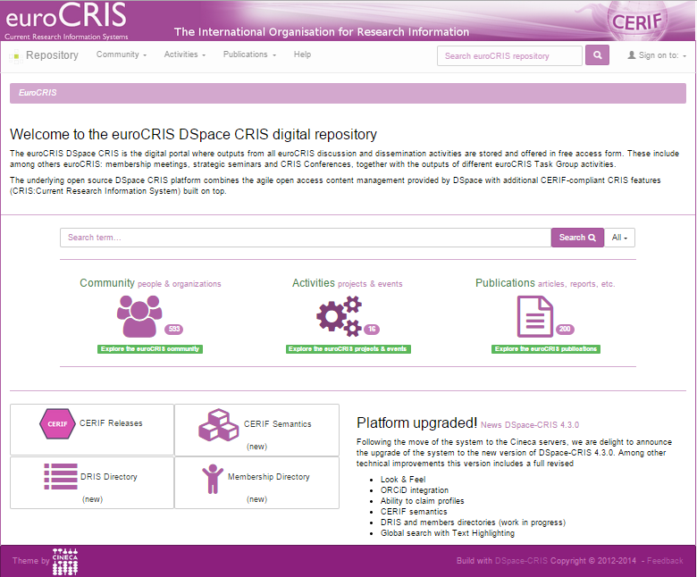

Slide 12
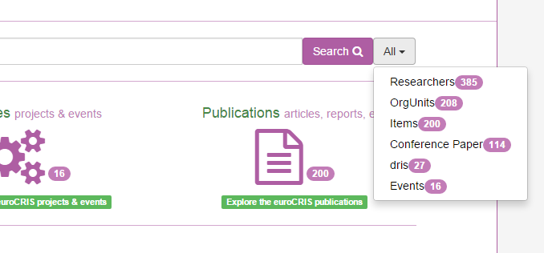

Slide 13
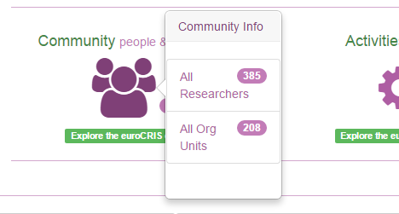
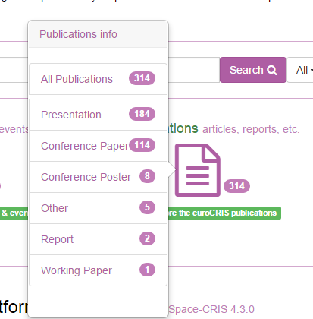
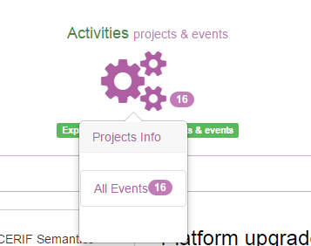

Slide 14
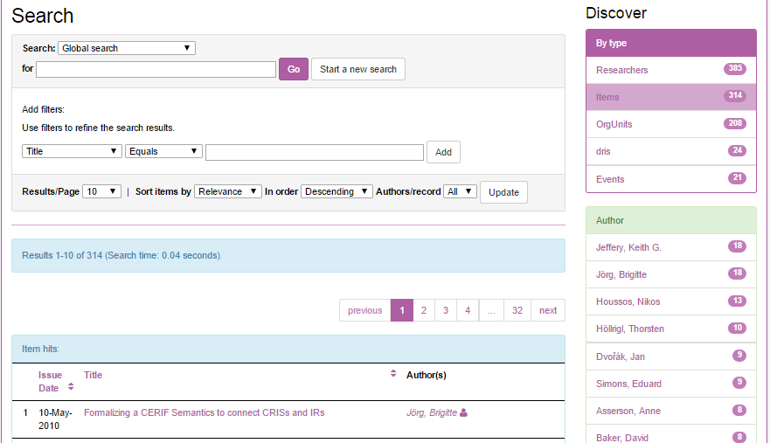
This is the clustering level
Contextual facets

Slide 15
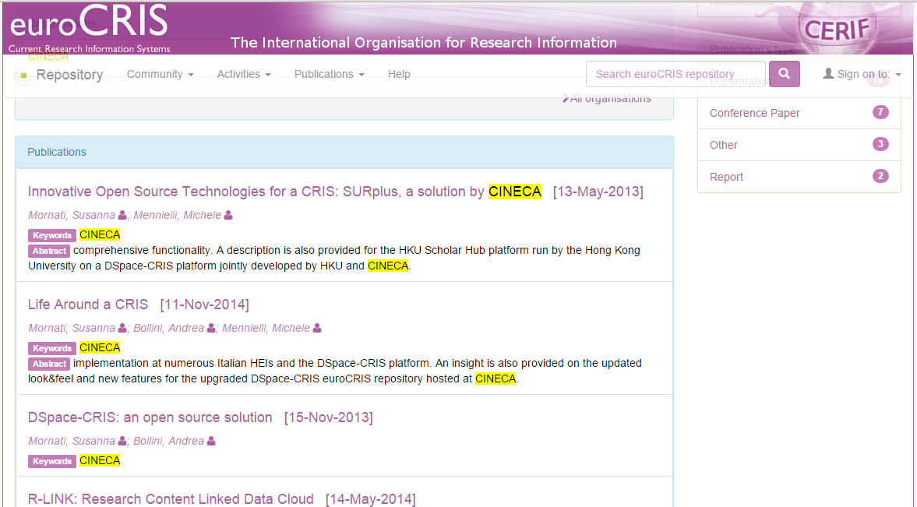

Slide 16
The new features
Two new standard home page components:
Big infographics summarizing the CRIS dimensions
Global search (inspired from Narcis.nl) google like with clustering and highlighting
Improved submission & ORCID integration
Creation on the fly of related objects
Ability to create text field that are resolved automatically as linkage (i.e. ORCID, ResearcherID, etc.)

Slide 17
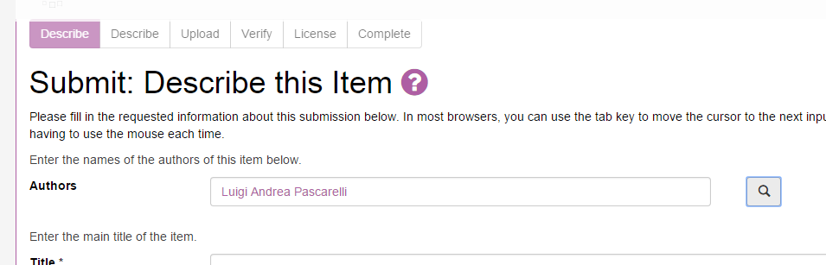
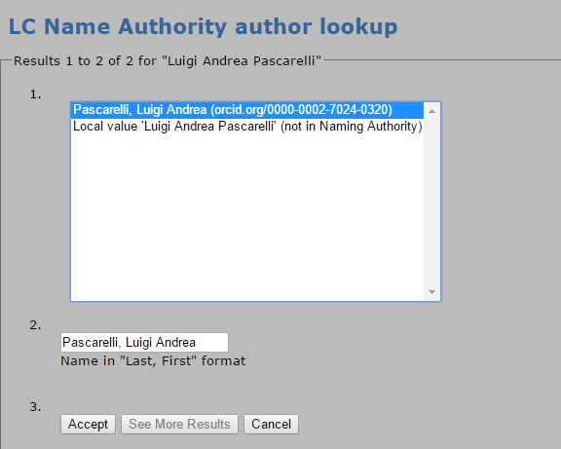

Slide 18
The new features
Two new standard home page components:
Big infographics summarizing the CRIS dimensions
Global search (inspired from Narcis.nl) google like with clustering and highlighting
Improved submission & ORCID integration
Creation on the fly of related objects
Ability to create text field that are resolved automatically as linkage (i.e. ORCID, ResearcherID, etc.)
18

Slide 19
Data load
We are implementing a generic tool to load, update and delete data in DSpace-CRIS using spreedsheet
This tool has been used to load data in the euroCRIS repository
Researcher Page (profile) enriching the data with ORCID, using just public API!
DRIS
Membership

Slide 20
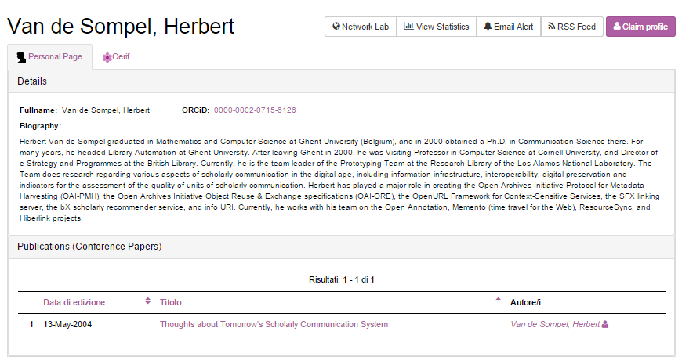

Slide 21
DSpace-CRIS e ORCID: next steps
Research’s bibliographic data
(including the possibility to activate synchronisation for single field)
Publications
(with the possibility to chose the publications to sync)
Projects
(with the possibility to chose which projects to sync)
PUSH local information to ORCID
Propose to import records in DSpace-CRIS when login-in looking to the Researcher’s ORCID profile
Or
Automatically (notification and preferences allowed) when ORCID premium membership is available
PULL extended information from ORCID

Slide 22
Next milestones
May: release of DSpace-CRIS 5.2.0 with the CSV import tool
June: PUSH services to ORCID, Researcher Page → ORCID record
Local identifier
Biographic information
Publications
Projects
September: PULL services from ORCID
Capture publications & projects
Retrieve biographic information
22
22

Slide 23
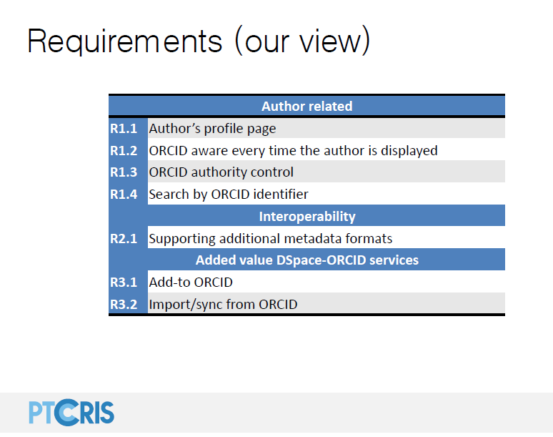
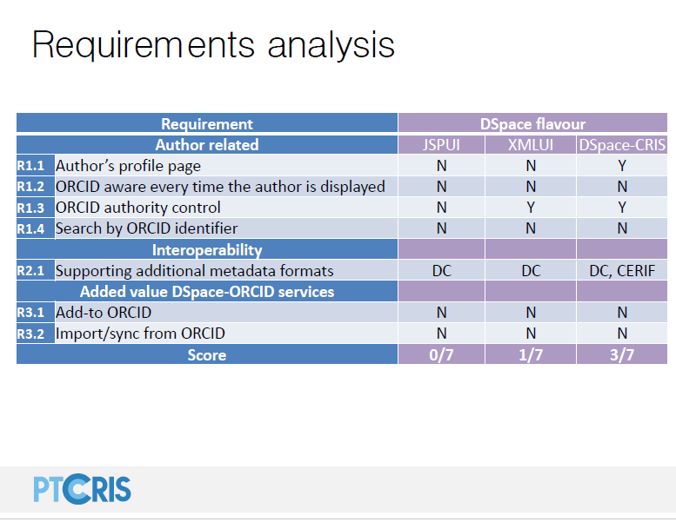
March 25, 2015
Now: 5/7
September: 7/7
Courtesy of Joao Moreira
http://www.slideshare.net/DuraSpace/32415-slides-new-possibilities-developments-with-dspace-and-orcid

Slide 24
Thank you
Andrea Bollini
a.bollini@cineca.it

